Slide 1
Docker DevOps
With focus on Microsoft stack including VSTS and Azure

Slide 2
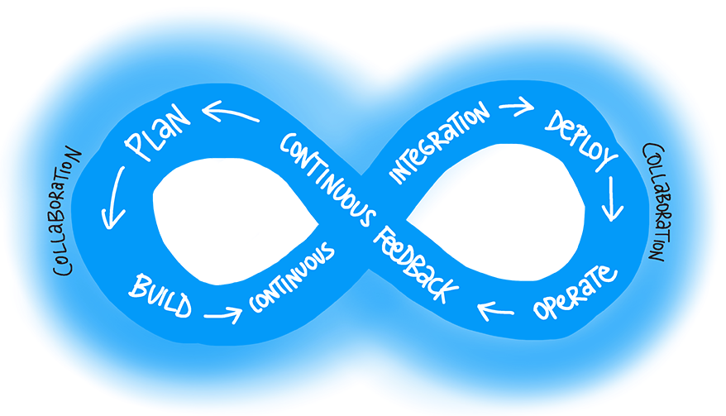
DevOps Philosophy

Slide 3
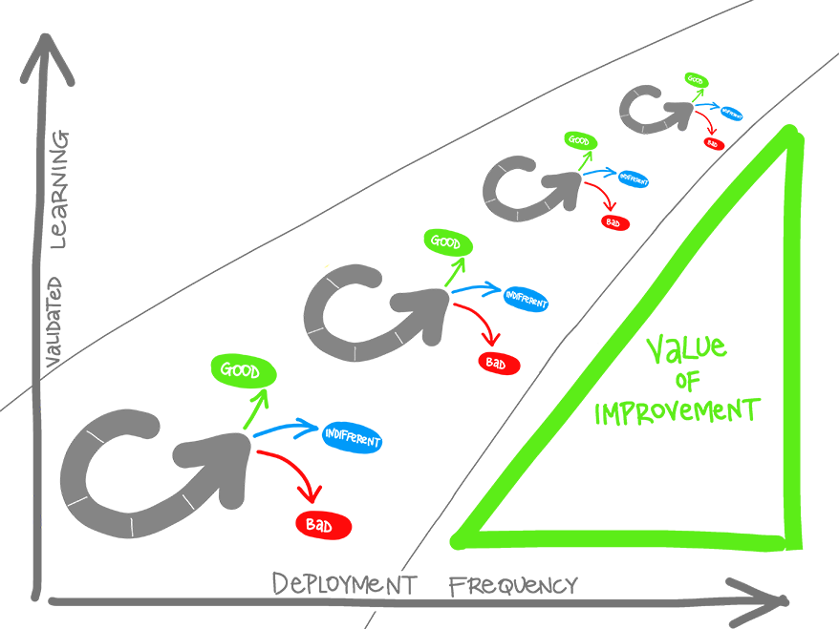
Value of DevOps
Validated Learning
Shorten Your Cycle Time
Eliminate Human Mistake
Accurate release management
Agile Organization
Reduce Costs
Manage Risk

Slide 4
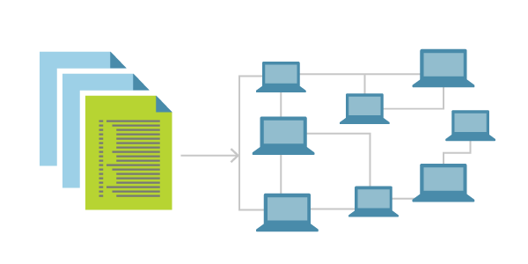
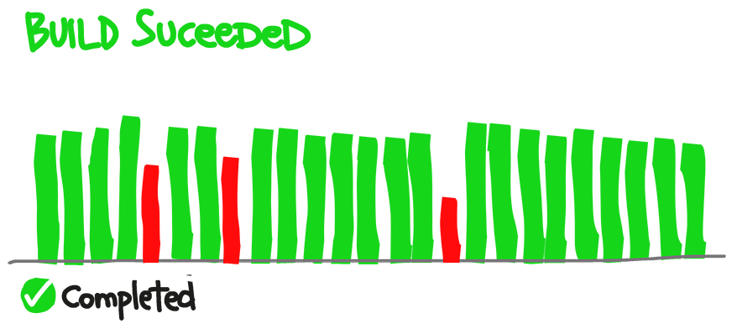
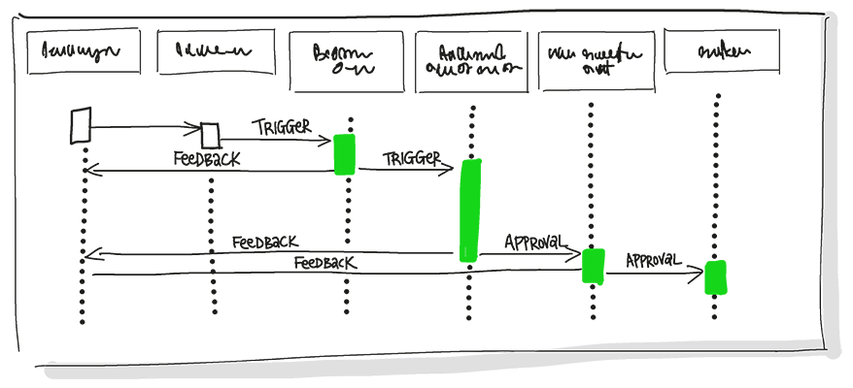
DevOps = Infrastructure As Code + Continuous Integration + Continuous Deployment

Slide 5
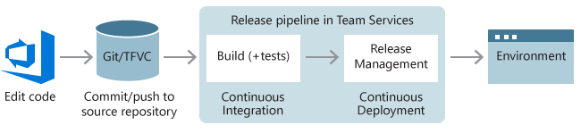
Traditional CI/CD

Slide 6
Pitfalls
Things work in Dev but not in production
It is not clear who is in charge of setting up the server to run the code

Slide 7
Dockers and Containers

Slide 8
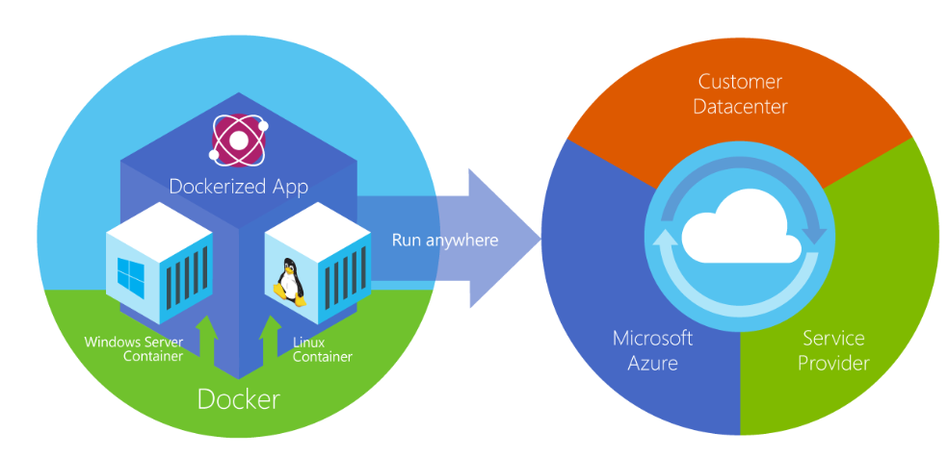
Dockerization: Implement once, run everywhere

Slide 9
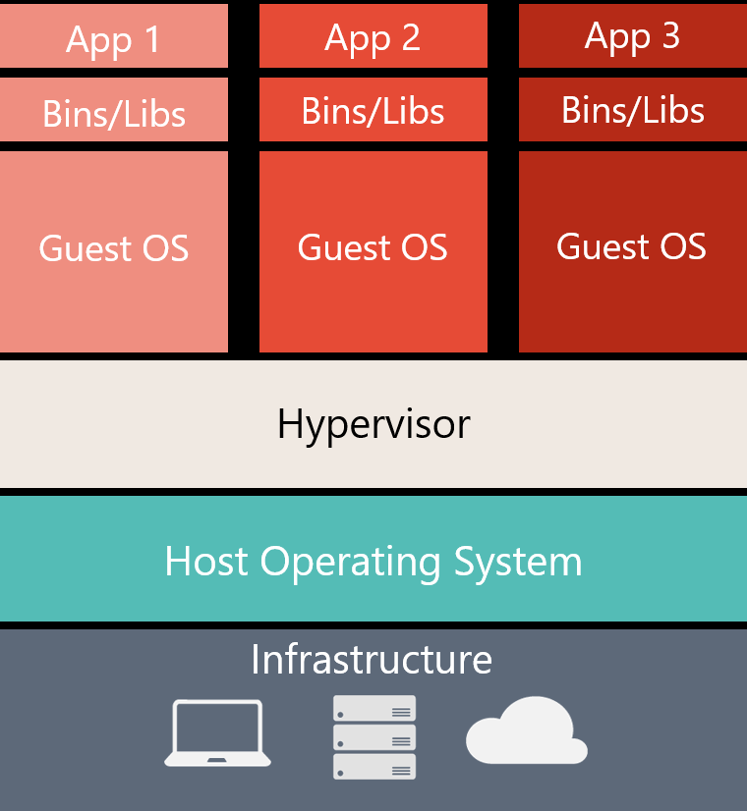
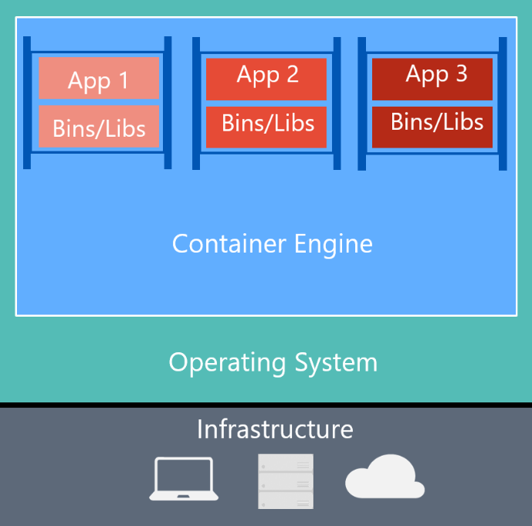
Virtual Machine vs Container

Slide 10
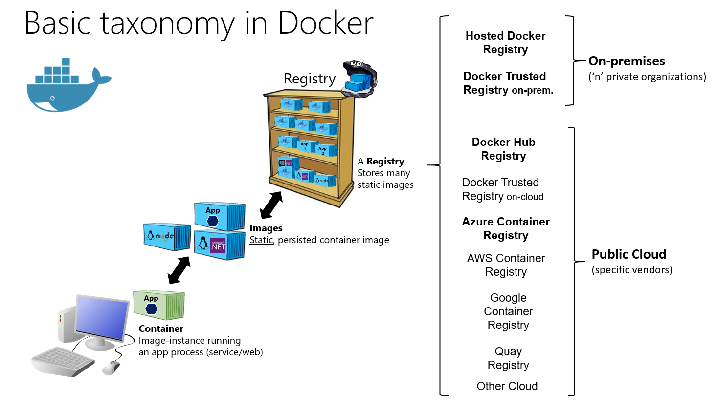

Slide 11
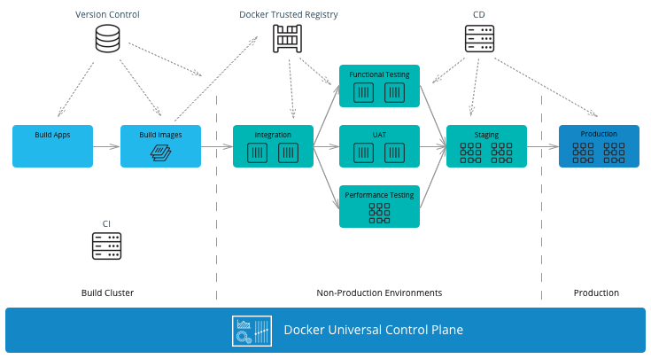
CI/CD With Docker

Slide 12
Docker in Practice
See: https://docs.docker.com/get-started/
Container
User DockerFile to specify the dependencies
Services
Multiple Containers
Use a simple docker-compose.yml
Swarm
A cluster of computers used to host the containers
One manager + multiple workers
Stacks
Connecting multiple services, network, and persistence mechanism using a complex docker-compose.yml

Slide 13
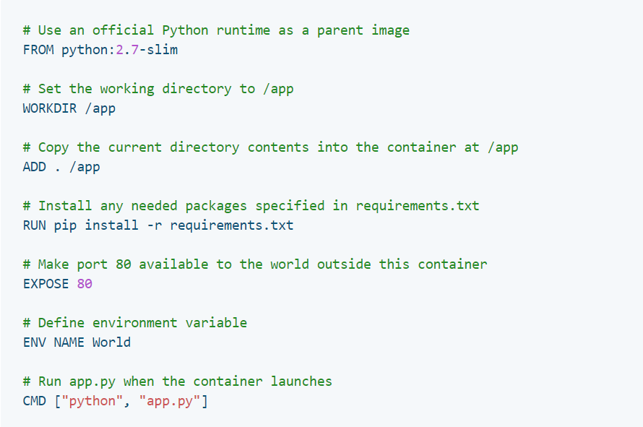
DockerFile
FROM microsoft/aspnet:4.6.2
ARG source
WORKDIR /inetpub/wwwroot
COPY ${source:-obj/Docker/publish} .

Slide 14
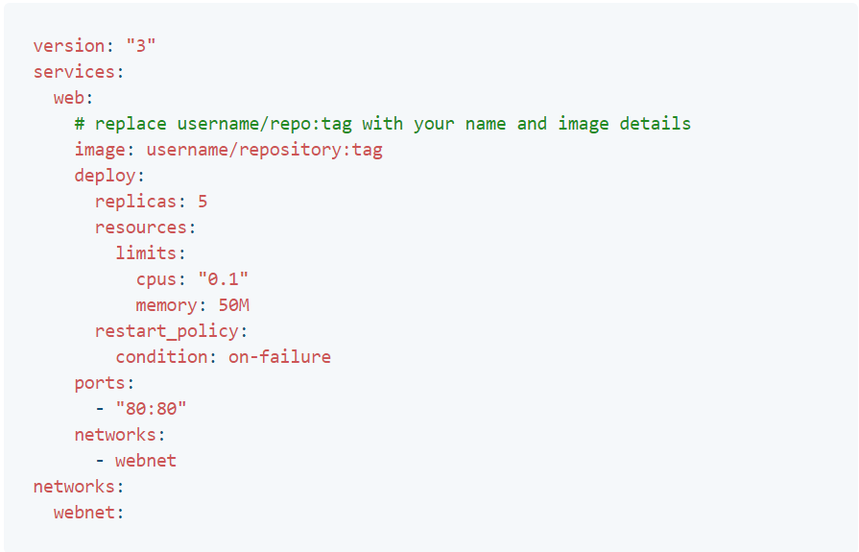
docker-compose.yml
version: '3'
services:
azuredevops:
image: azuredevops
build:
context: .\AzureDevOps
dockerfile: Dockerfile
ports:
- "80"
networks:
default:
external:
name: nat

Slide 15
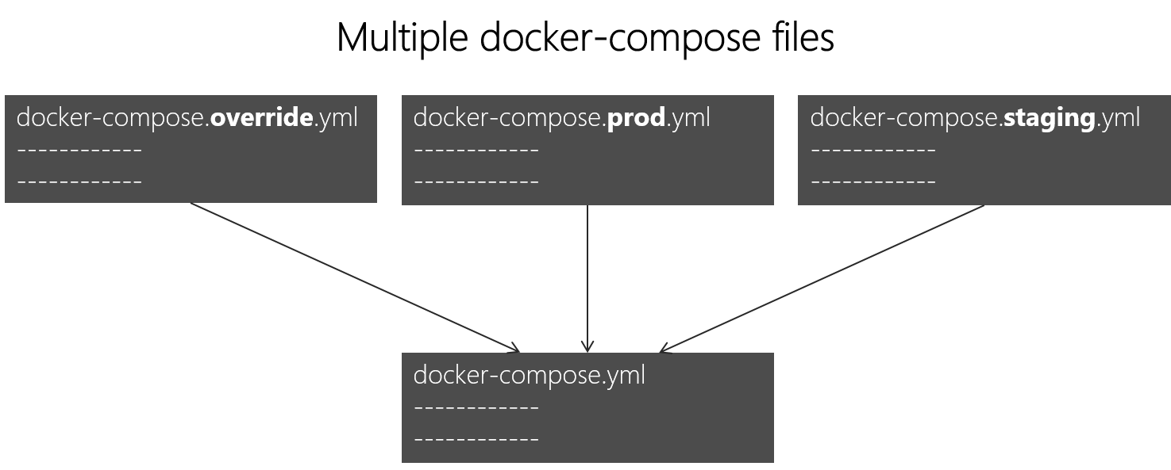
Docker Compose Files

Slide 16
VSTS Integration

Slide 17
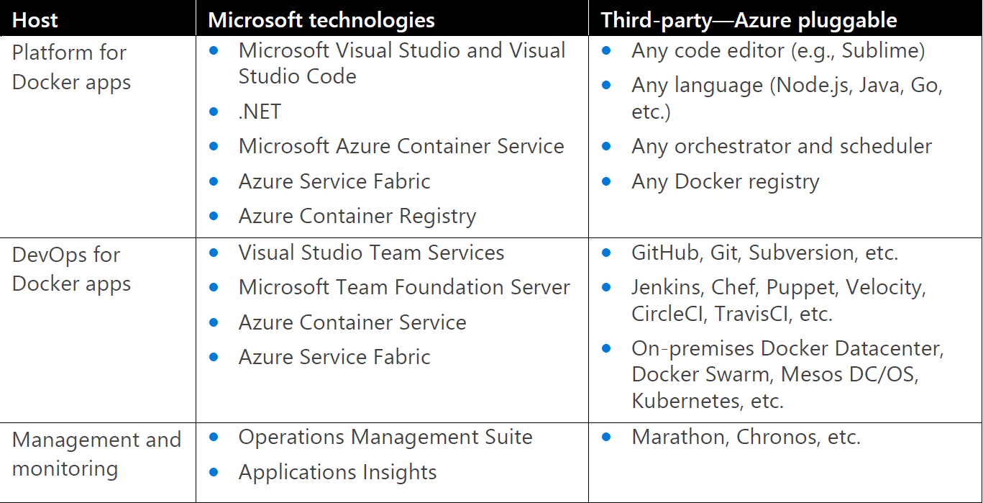
DevOps Tools: Microsoft vs Others

Slide 18
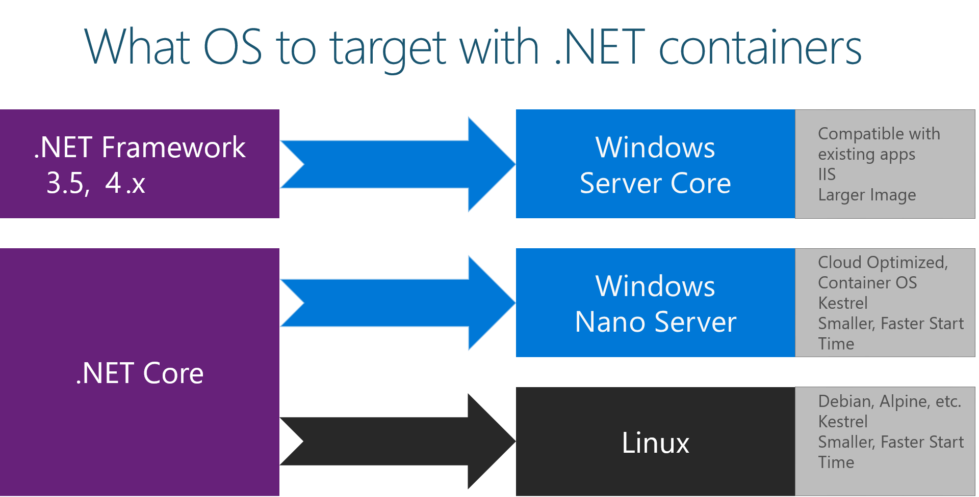
More Specific Tools for .NET Based Apps
Criteria | .NET CORE | .NET FRAMEWORK
OS Type | Any | Windows Only
App Type | Console, API, Light ASP.NET | WPF, WCF, WW, SignalR
Architecture Type | Microservices | Monolithic
Project Type | New | Existing

Slide 19
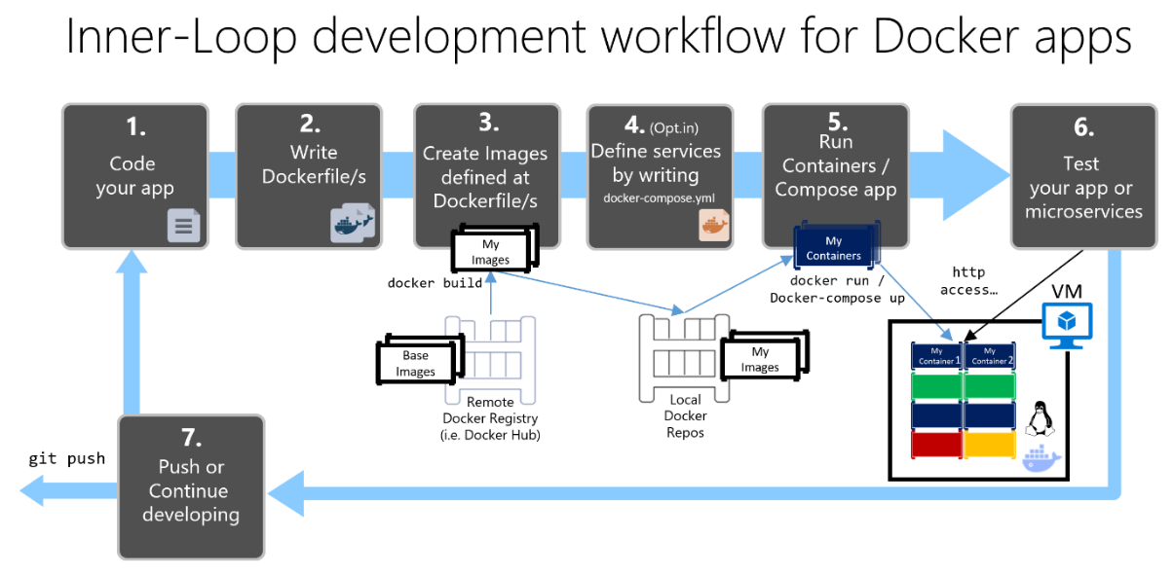

Slide 20
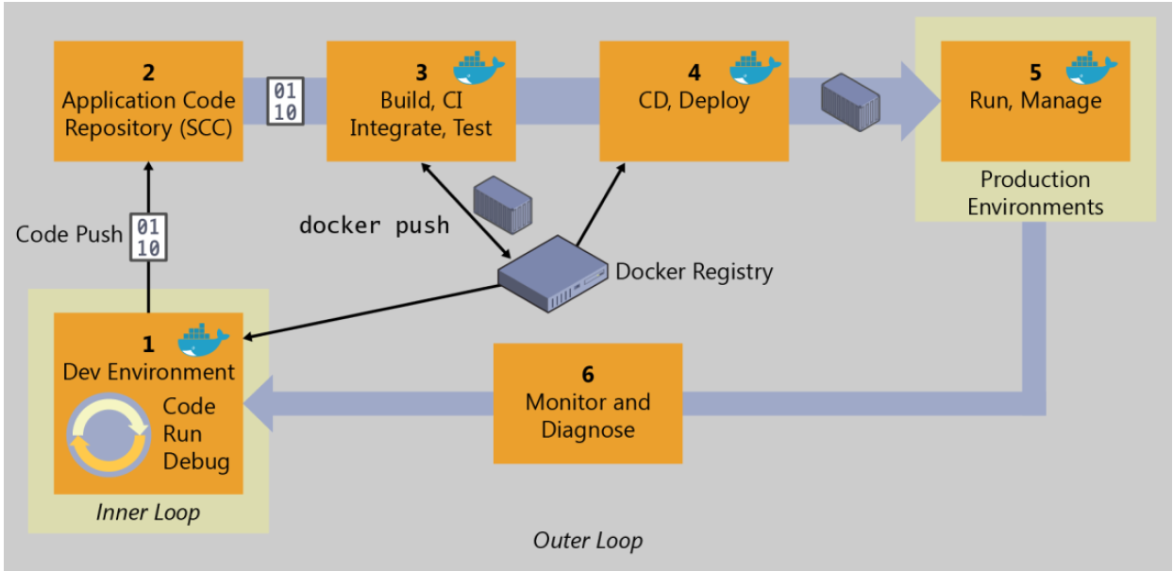
End-to-End Docker DevOps Workflow

Slide 21
Demo 1: Inner Loop
Build an ASP.NET project
Enable Docker Support
Build in release to create the image in /obj/publish folder
docker images shows the image added to local docker repo
docker run -d -p:1234:80 [image name] to run the container
docker container ls to list running containers and see the container id
docker inspect [container id] to get the IP address the container is assigned (windows by default assgin an ip in range of 172.24/16.
Browse to [IP Address]:1234

Slide 22
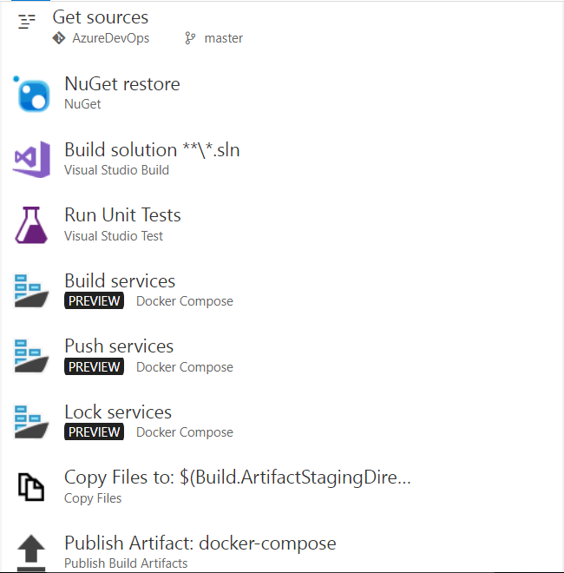
CI with VSTS to Azure
Go to VSTS and add a definition based on ASP.NET with Containers
Add a test step to run unit tests
Edit the definition and change host to VS2017 (it understand docker)
Set the trigger to run after each push

Slide 23
Demo 2-A: CI to Azure
Add some logic to ASP.NET controller and add a unit test for it
Push the code to GIT
Go to VSTS and see that a build is triggered
When build is over look at results of running unit tests
Open up the azure image registry and see that a new image is added
Pull the image on local and run it
Need to login to Azure Container Registry: docker logins –u [username –p password]

Slide 24
CI with VSTS for Docker
Add a docker-enabled VSTS host. Two options:
Regular private VSTS agent.
VSTS + Docker agent Linux container: https://hub.docker.com/r/microsoft/vsts-agent/
Docker-compose.ci.build.yml should contain repo namespace
thelmi/azuredevops
The docker image endpoint should not contain the namespace:
https://index.docker.io/v1/
The project name should be all lowercase

Slide 25
Demo 2-B: CI to Docker
Add some login to ASP.NET controller and add a unit test for it
Push the code to GIT
Go to VSTS and see that a build is triggered
When build is over look at results of running unit tests
Open up the Docker registry and see that a new image is added
Pull the image on local and run it

Slide 26
CD: Azure Container Services
Create a ACS in swarm mode in Azure.
In order to generate ssh key you can PuttyGen on windows makes sure to save the private key with passphrase to be able to ssh to the master node.
Can connect to the master node using SSH:
ssh thelmi@azuredevopscoremgmt.eastus.cloudapp.azure.com -A -p 2200

Slide 27
Azure Container Services Swarm

Slide 28
Demo 3-A: CD to Azure

Slide 29
Demo 3-B: CD to Docker Swarm

Slide 30
Implementation Strategy

Slide 31
Step 1 - Set up the DevOps Pipeline
Build Servers
Environments
Image Registry
Swarm Clusters
CI/CD Definitions

Slide 32
Step 2 - Dockerize
New/Stateless Application
Define dockerfile and docker-compose.yml
State-ful Application
Application servers with stateful applications
Load balancer with session affinity to ensure the user always goes to the same container instance
External session persistence mechanism which all container instances share
Databases
Only containerize the Engine and not the data itself. This can be done using a host volume
Applications with shared filesystems
Use a host volume which is often mounted to a shared files ystem
Complex existing Application
Run container, install the product, and then save the changes to an image

Slide 33
Step 3 - Define Image Components
Base Image | Release Image | Environment Image
What's inside the image | OS, middleware, dependencies | Base image, release artifacts, configuration genericto the environment | Release image, configuration specific to the environment
What's outside the image | Release artifacts, configuration, secrets | Configuration specific to the environment, secrets | Secrets
Advantages | Most flexible at run time, simple, one image for all use cases | Some flexibility at run time while securing a specific version of an application | Most portable, traceable, and secure as all dependencies are in the image
Disadvantages | Less portable, traceable, and secure as dependencies are not included in the image | Less flexible, requires management of release images | Least flexible, requires management of many images
Examples | Tomcat (dtr.example.com/base/tomcat7:3) | Tomcat + myapp-1.1.war (dtr.example.com/myapp/tomcat7:3) | Tomcat + myapp-1.1.war + META-INF/context.xml (dtr.example.com/myapp/tomcat7:3-dev)

Slide 34
Step 4 – Specify Configuration Management
When | What | Where
Yearly build | Enterprise policies and tools | Enterprise base image Dockerfiles
Monthly build | Application policies and tools | Application base image Dockerfiles
Monthly/weekly build | Application release | Release image Dockerfiles
Weekly/daily deploy | Static environment configuration | Environment variables, docker-compose, .env
One-off Deploy | Dynamic environment configuration | Secrets, entrypoint.sh, vault, CLI, volumes
Run | Elastic environment configuration | Service discovery, profiling, debugging, volumes

Slide 35
Microservices Architecture

Slide 36
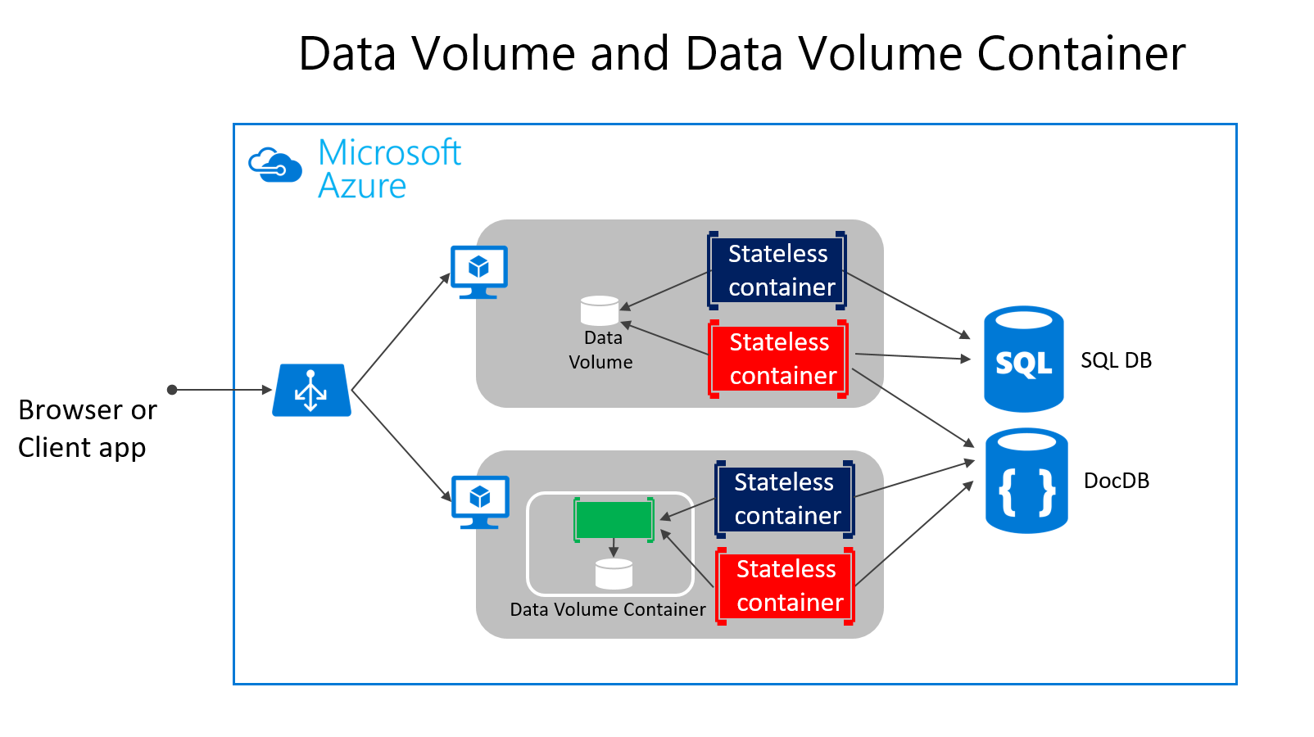
Application Architecture – State Management
Data Volume
SQL/No SQL/Cache
Data Volume Container
Volume Plugin

Slide 37
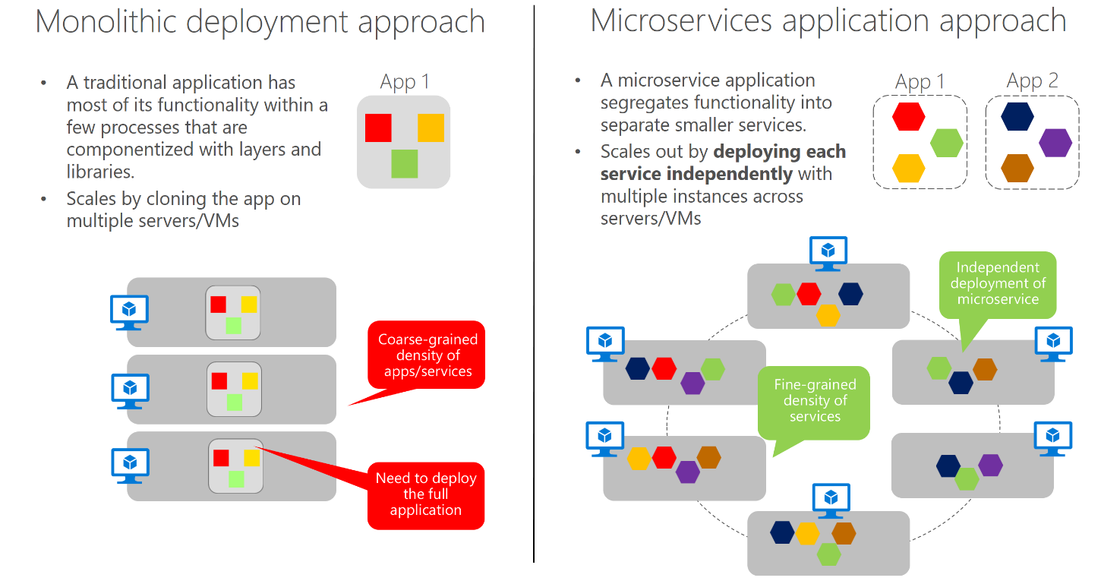
Application Architecture - Composition

Slide 38
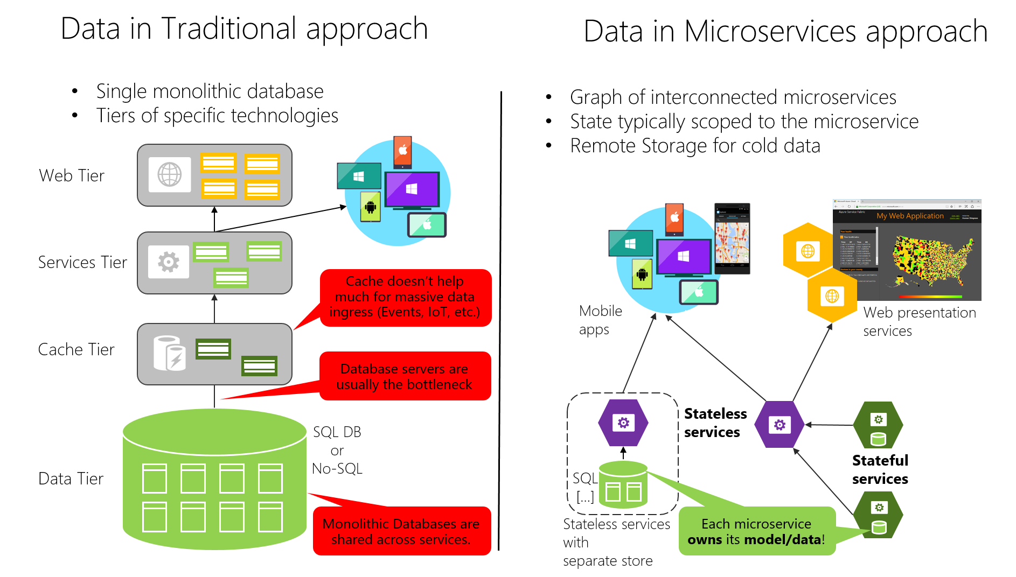
Application Architecture – Data Composition

Slide 39
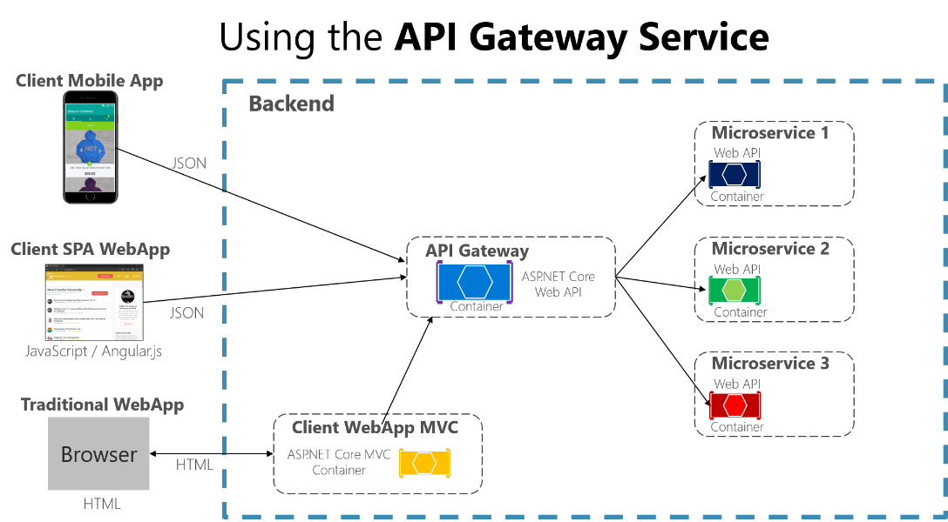
Application Architecture – Access Control
Security
Routing
Quotas
Caching

Slide 40
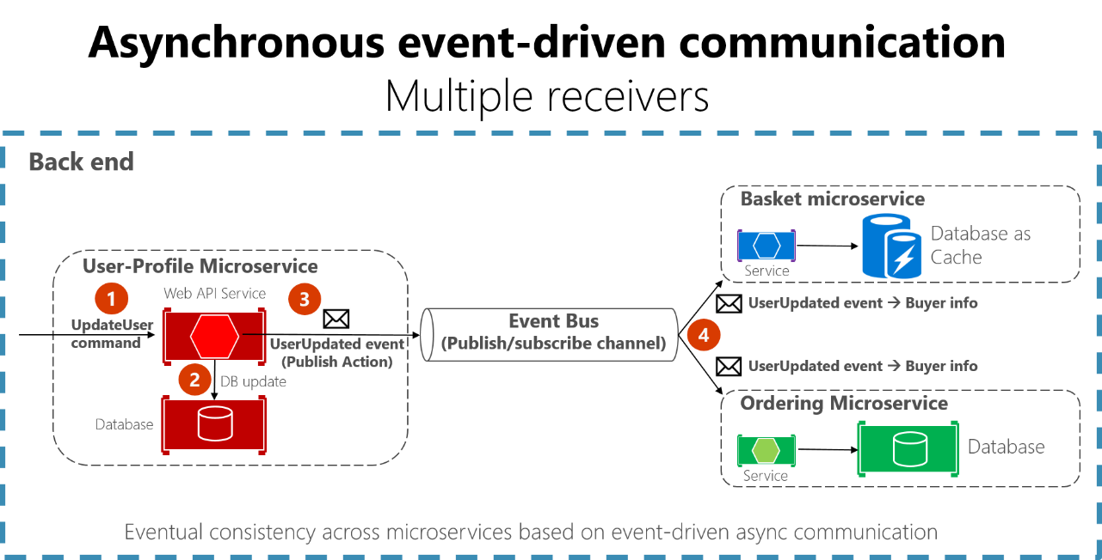
Application Architecture - Communication

Slide 41
Windows Container Networking

Slide 42
To do
https://docs.microsoft.com/en-us/virtualization/windowscontainers/manage-containers/container-networking

Slide 43
Nano Server

